Slide 1
By using the link below login using guide username and password
https://ipronline.ipindia.gov.in/epatentfiling/patForms/UploadDocument.aspx

Slide 2
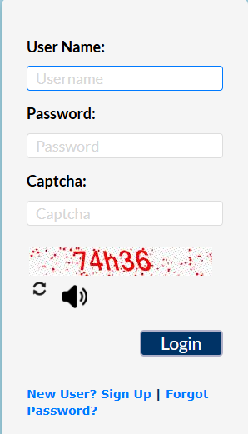
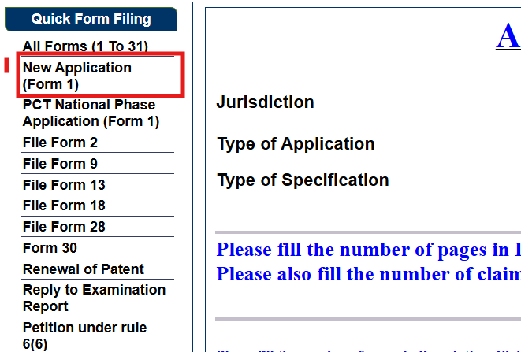
Login with Emudra Logins
Select the New Application

Slide 3
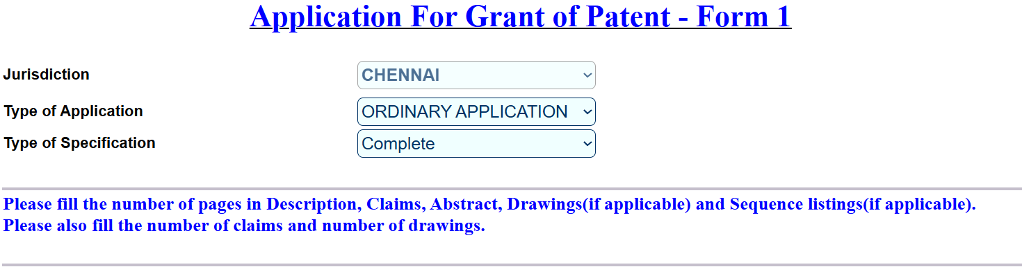

Slide 4
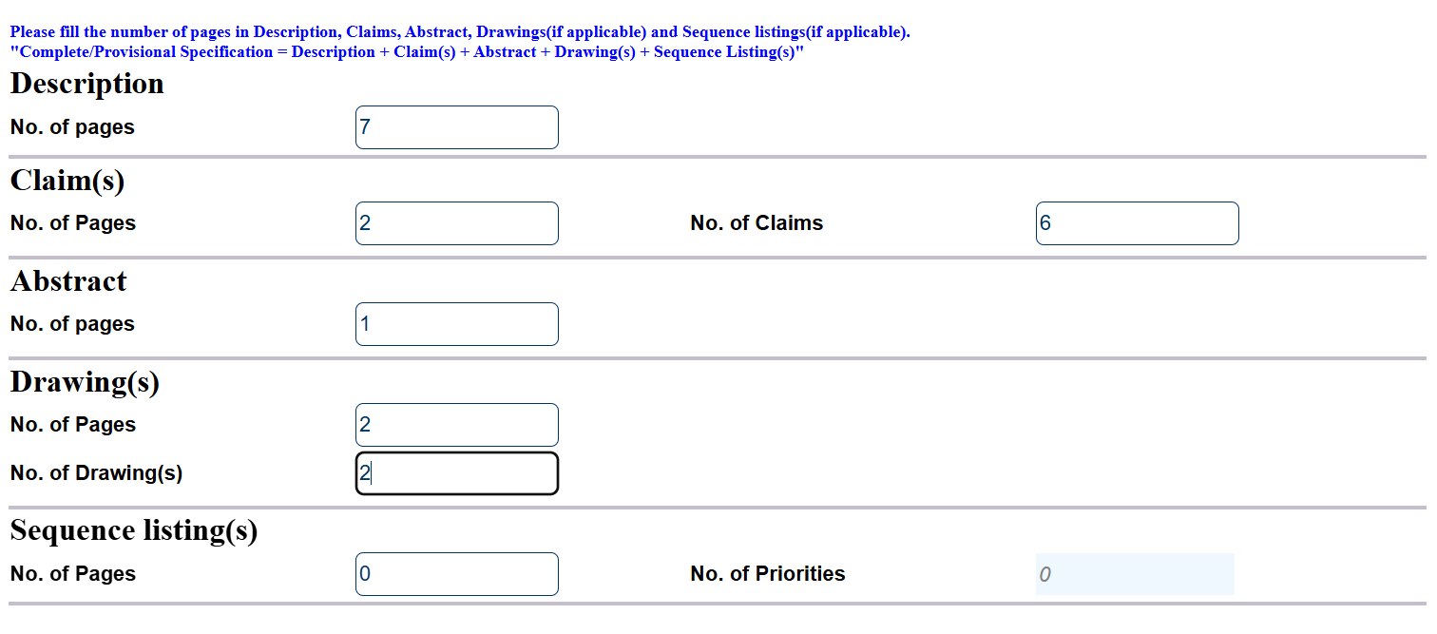
Fill All details
Count here from preamble of description to summary of invention

Slide 5
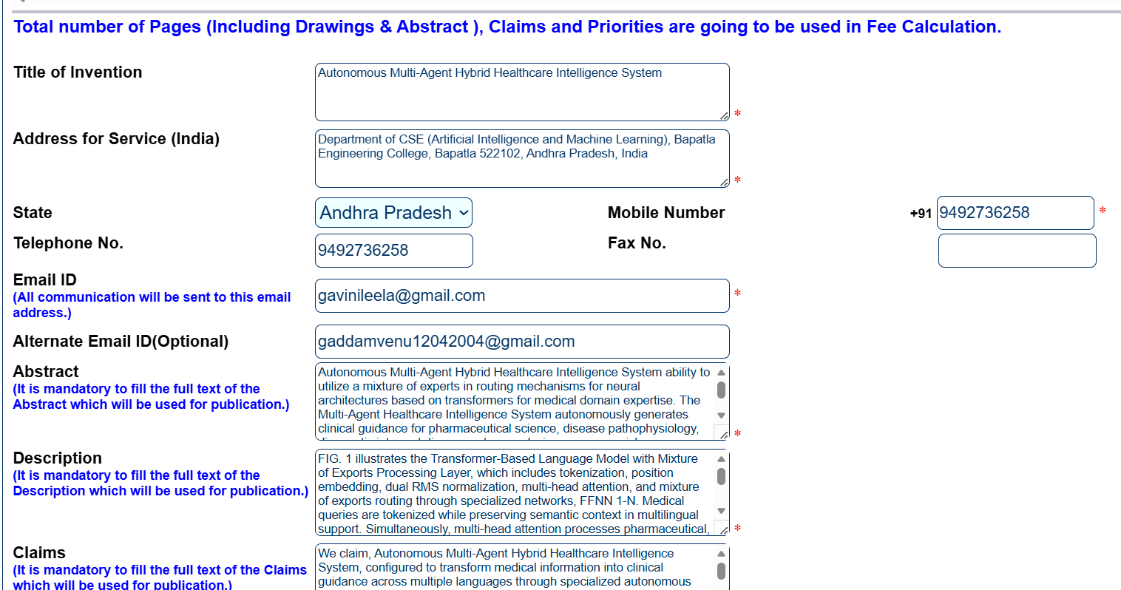
Emudra Login Member details

Slide 6
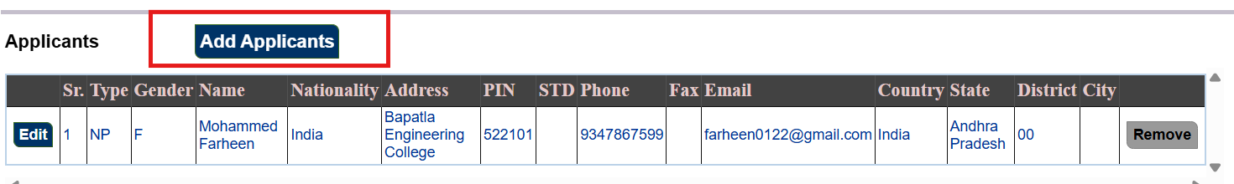
Click Add Applicants to Upload Team member details
In applicants add bapatla engineering college as applicant number 6

Slide 7
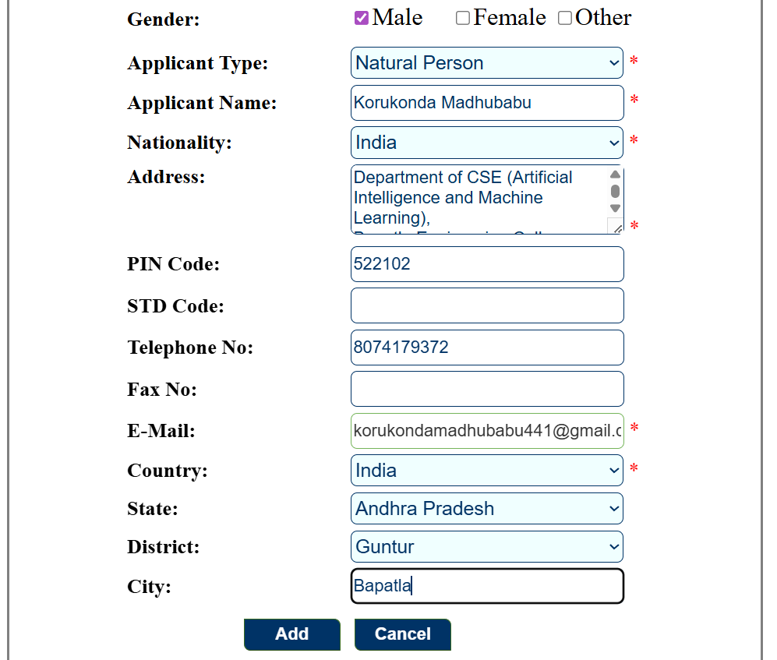
For add applicants fill in the details as shown below and click add
Fill the applicant details for all the applicants

Slide 8

Click the checkbox

Slide 9
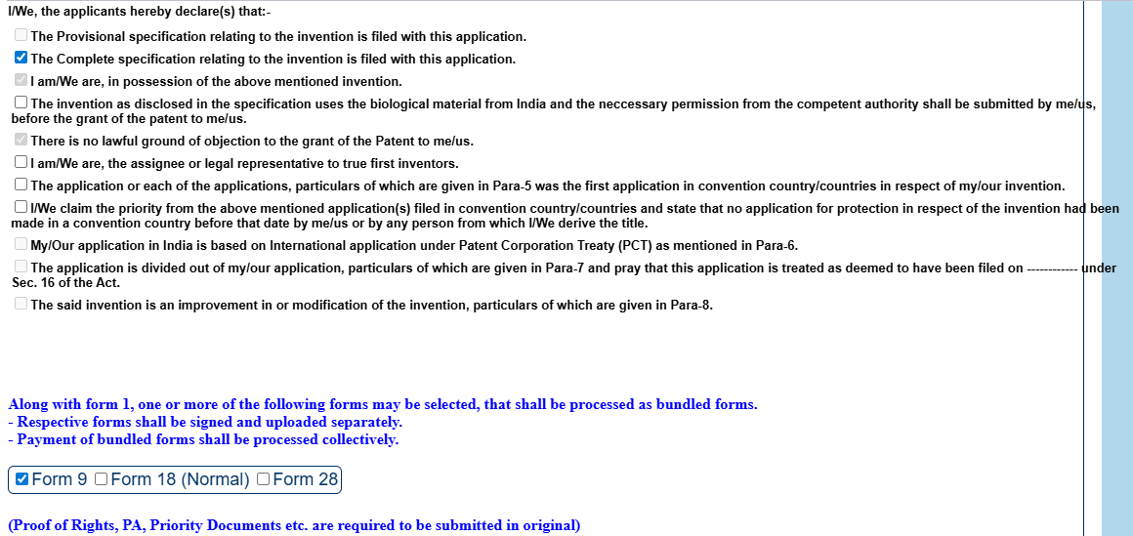
Select the checkboxes shown below

Slide 10
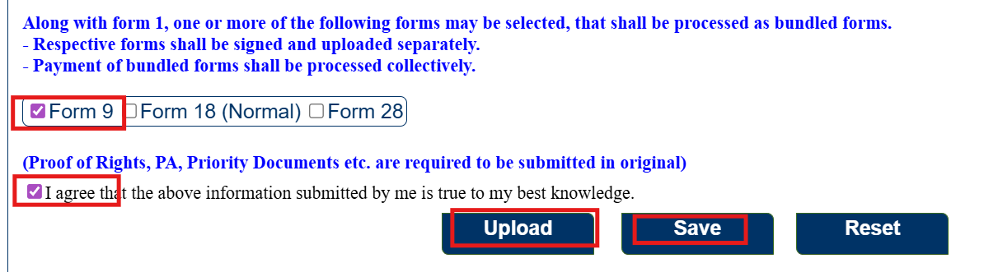
Click Form 9 check box and Fill the checkbox below click save button click upload Button

Slide 11
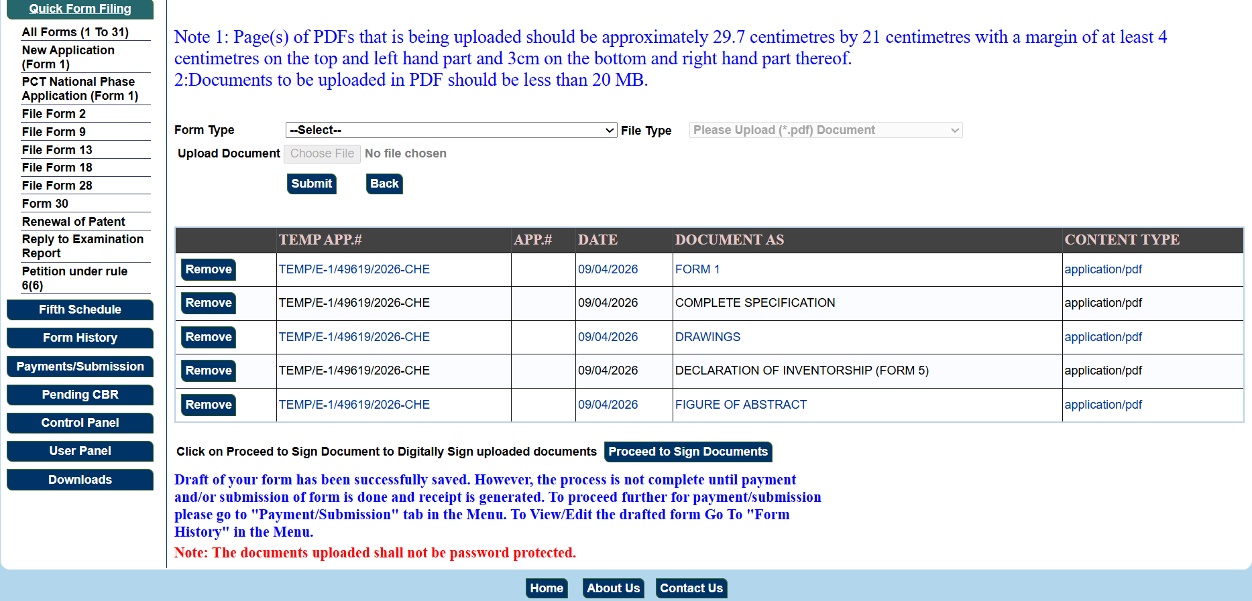
Click to Proceed to Sign Document
It comes an error : Come to Home Page

Slide 12
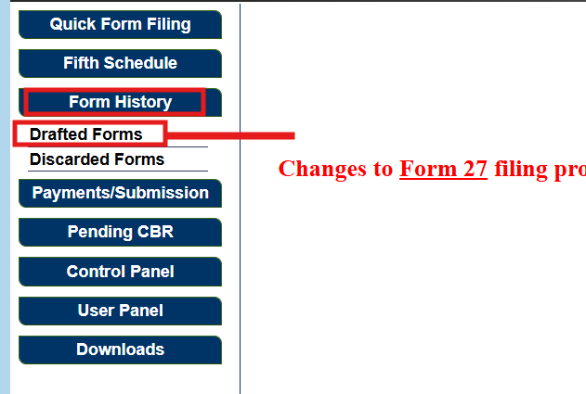
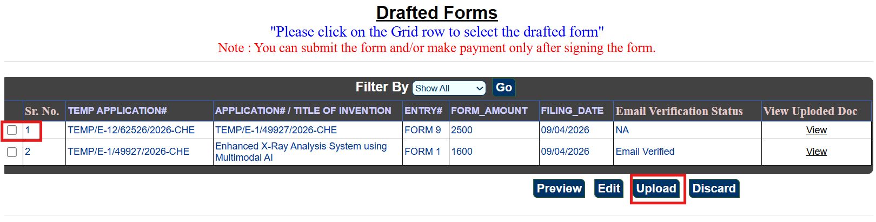
Click the Drafted Forms here
Here, click the check box and after click upload button

Slide 13
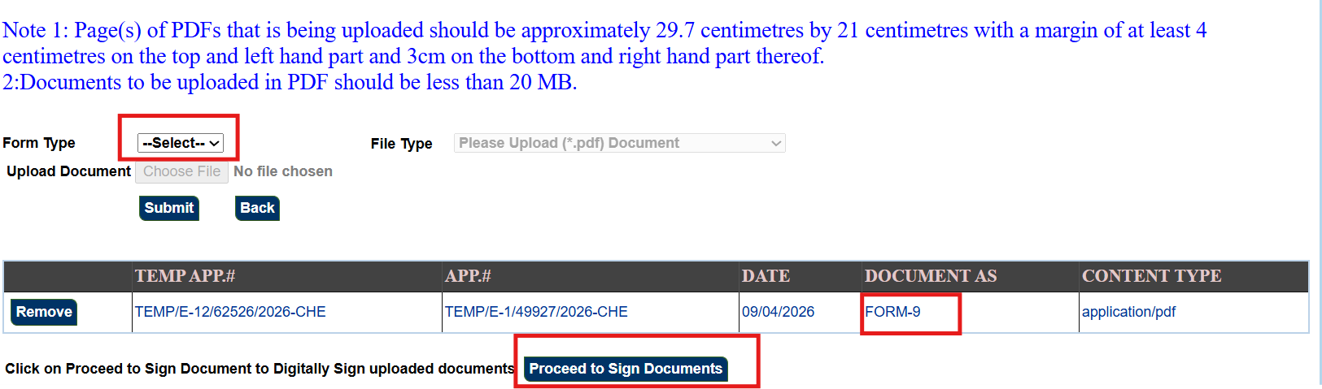
Select Form 9 and Upload here: then click Proceed to Sign Documents

Slide 14
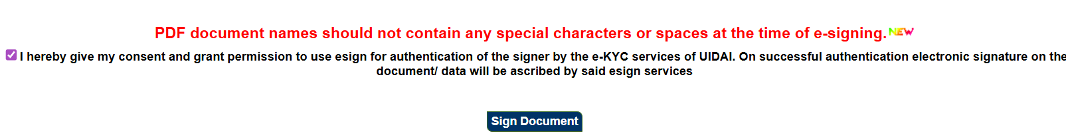

Slide 15
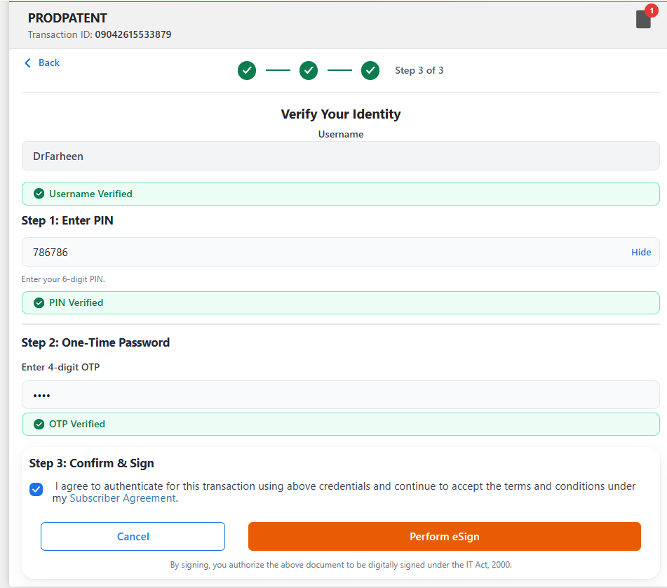

Slide 16
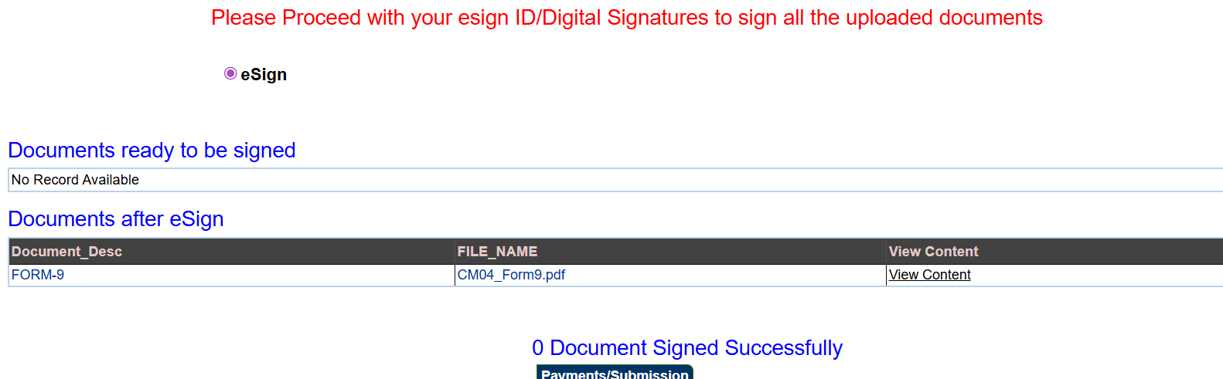









Here First Comes Document verify after this click then above image comes
Again goto Same Page Home – Form History: Drafted Forms

Slide 17
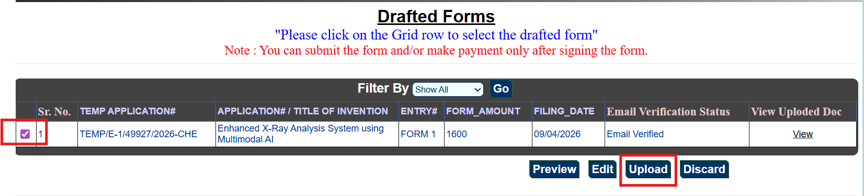
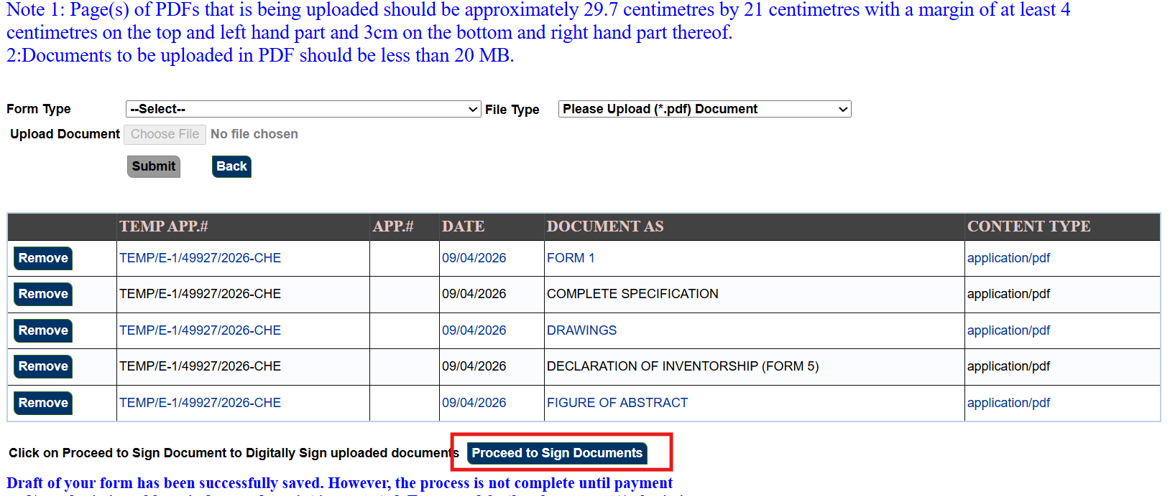

Slide 18
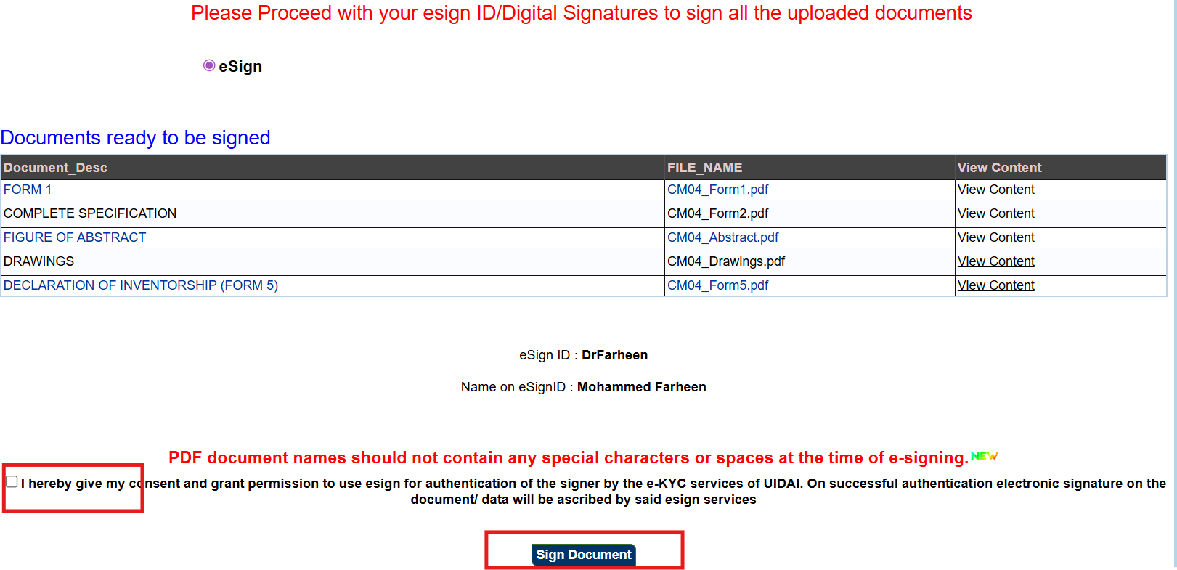

Slide 19
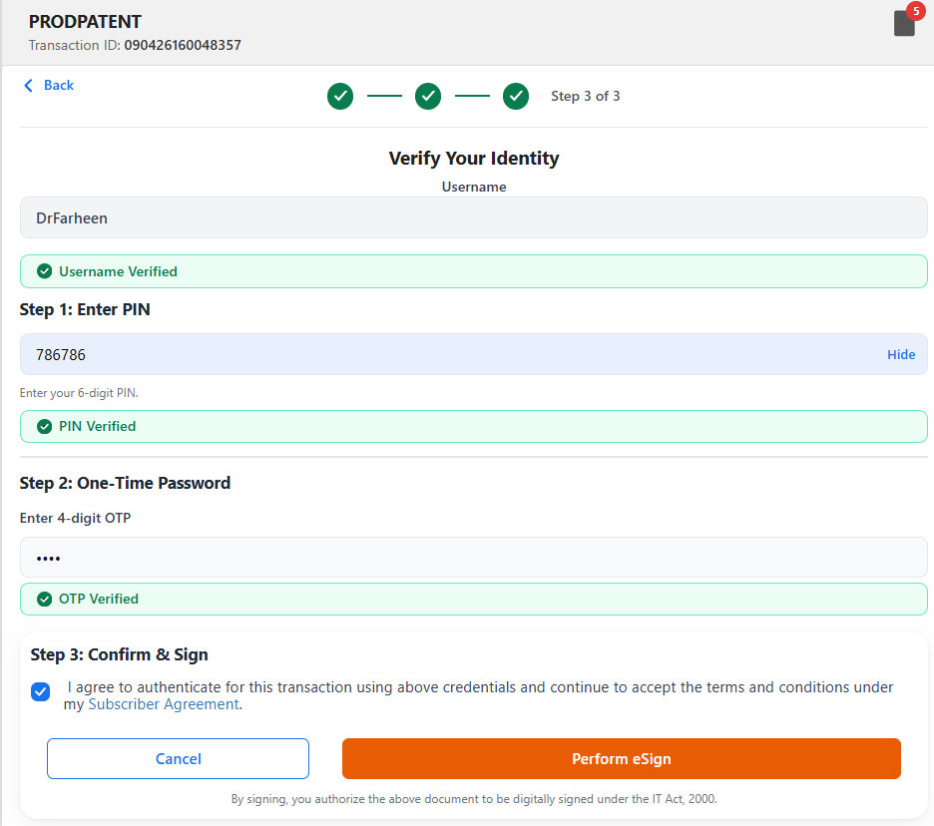

Slide 20
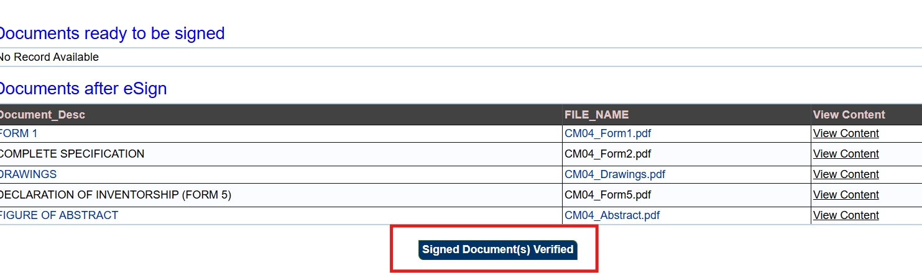
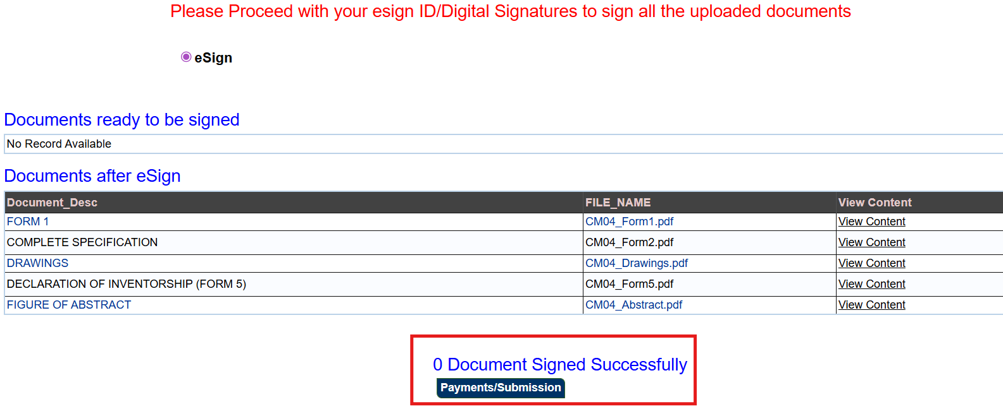

Slide 21
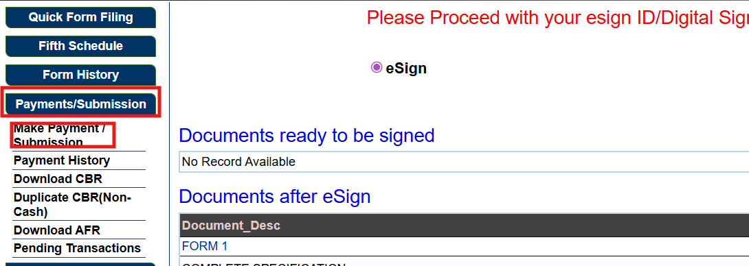
After this goto payment Section

Slide 22
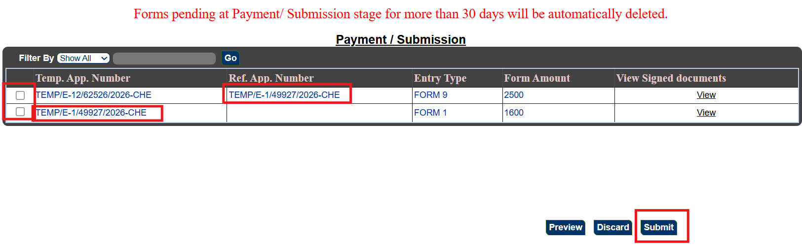

Slide 23
